Slide 1
Shalini Gupta

Slide 2
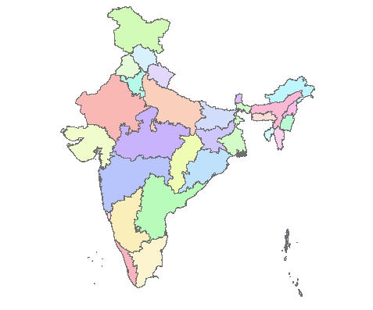
From...
Mumbai
Beohari

Slide 3
Educational Background
Five Year Integrated M.Sc. in Physics
UM – DAE Centre for Excellence in Basic Sciences, Mumbai
M.Sc. Dissertation
Synthesis & Characterization of
Transition Metal Dichalcogenides
Prof. Arnab Bhattacharya

Slide 4
Started working at
since September1st

Slide 5
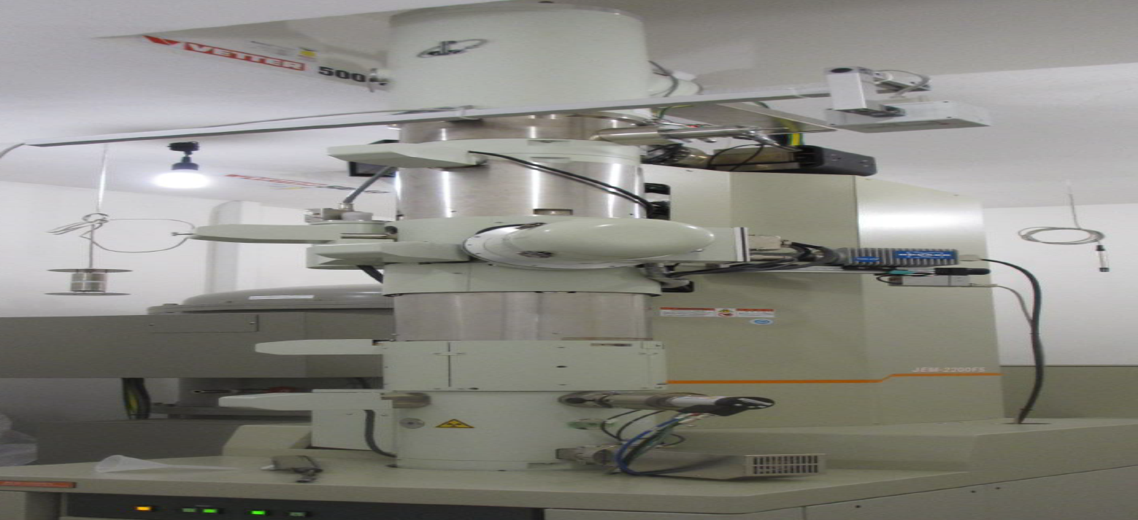
My Project
Growth and Characterisation of Dilute Nitride Ga(NAsP)/Si and (GaIn)(NAs)/GaAs
Prof. Kerstin Volz
JEM-2200FS TEM

Slide 6
why promis?

Slide 7
Thank you !!

